Slide 1
Topic Models

Slide 2
What and Why of Topic Mining
What is Topic Modeling?
Unsupervised learning technique to discover hidden topics in a collection of documents.
Groups similar words together → Forms topics.
Each document is represented as a mixture of topics.
Why Topic Modeling?
Summarize large document collections.
Find patterns/themes without labels.
Assist search, recommendations, document organization.
Goal: Understand the structure of text automatically!

Slide 3
How Topic Modelling Works
General Steps:
Step | Description
1 | Preprocess the text (cleaning, lemmatization)
2 | Represent documents using BoW or TF-IDF
3 | Apply a topic modeling algorithm (LDA, LSA, etc.)
4 | Interpret and label discovered topics

Slide 4
Types of Topic Modeling Algorithms
Common Topic Modeling Techniques:
Technique | Brief Description
LDA (Latent Dirichlet Allocation) | Probabilistic model assuming each document is a mixture of topics, and each topic is a mixture of words
LSA (Latent Semantic Analysis) | Matrix decomposition (SVD) method capturing hidden patterns in word co-occurrence
NMF (Non-negative Matrix Factorization) | Another matrix factorization method that identifies additive combinations of topics
HDP (Hierarchical Dirichlet Process) | Extension of LDA that decides the number of topics automatically

Slide 5
Overview of LDA (Latent Dirichlet Allocation)
What is LDA?
Probabilistic Generative Model.
Documents are assumed to be mixtures of topics.
Each topic is assumed to be a distribution over words.
LDA Intuition:
For each document:
Randomly pick a topic distribution.
For each word:
Pick a topic from the document’s topic distribution.
Pick a word from the topic’s word distribution.
Output: Topics + Topic distribution for each document.
Very powerful and widely used in real-world applications!

Slide 6
pyLDAVis
Understanding Lambda
Lambda Value | Interpretation
λ = 1 | Rank terms purely by probability inside the topic (term frequency only)
λ = 0 | Rank terms purely by uniqueness to the topic (exclusive to that topic)
0 < λ < 1 | Blend of frequency and uniqueness
Specifically: λ = 1 means
Terms shown are sorted purely by how frequent they are inside the topic.
No consideration of how "unique" they are compared to other topics.
So common words across topics may appear higher.
Good if you want to see what terms dominate a topic.

Slide 7
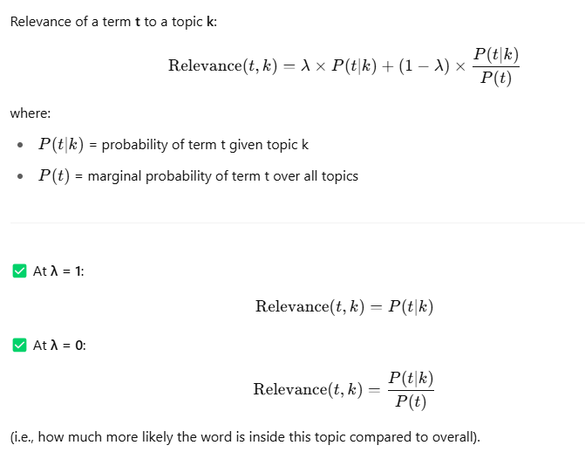
Simple Language
λ value | Meaning | What you see
λ = 1 | Frequency focus | Common but important words (like "data", "learning")
λ = 0 | Exclusivity focus | Unique specialized words per topic (like "gradient", "genomics")
0 < λ < 1 | Mix | Balanced view

Slide 8
LSA (Latent Semantic Analysis)
Matrix factorization method (using Singular Value Decomposition — SVD).
Captures hidden structures (latent semantics) between terms and documents.
Reduces original text data into a lower-dimensional space.
Idea: Words that occur in similar contexts have similar meanings.
✅ No probabilities, no generative process. ✅ Mathematical — based on linear algebra.
"LSA finds hidden patterns via matrix math, while LDA models documents probabilistically as mixtures of topics."

Slide 9
LDA Vs LSA
Feature | LSA | LDA
Technique | Matrix factorization (SVD) | Probabilistic modeling (Bayesian inference)
Output | Topics as dense vectors | Topics as probability distributions
Interpretability | Harder (topics are mathematical directions) | Easier (topics are word distributions)
Handles Polysemy (multiple meanings)? | No | Better (context based on distribution)
Number of Topics | Set manually | Set manually (or auto in HDP extension)
Common Use | Semantic similarity, search engines | Topic modeling, document clustering
LSA = pure math and linear patterns in text.
LDA = assumes documents are generated via hidden topics — more natural and interpretable

Slide 10
When to prefer LDA and when LSA
Aspect | LDA (Latent Dirichlet Allocation) | LSA (Latent Semantic Analysis)
Goal | Discover hidden topics in documents | Capture semantic structure of documents
Mathematical Base | Probabilistic modeling | Linear Algebra (SVD)
Input Data | Bag of Words (word counts) | TF-IDF (weighted frequencies)
Output | Topic distribution per document | Document embeddings in topic space
Interpretability | High (topics have clear meaning) | Medium (topics are abstract vectors)
Use Case | When you want explainable, human-readable topics | When you want clustering, retrieval, semantic search
Best For | Topic labeling, document classification, storytelling | Search engines, information retrieval, text similarity
Weakness | Slow for very large corpora, hyperparameter sensitive | Topics less interpretable, sensitive to noise

